Slide 1

Review Classifier
Presented by:
Sai Teja Gattu
Karthik Sai Borra

Slide 2
INTRODUCTION
” your most unhappy customers are your greatest source of learning” – Bill Gates
In this modern era reviews are very important for both producers and the consumers, whether its a movie, restaurant or any kind of product and analyzing these reviews properly is also very important to get the accurate results
In this project the user reviews are analyzed and classified by using various machine learning techniques such as KNN and MultiNomial and the graphical reviews of the data is displayed as the end result

Slide 3
OBJECTIVE
Finding a method to analyze reviews and to determine the most accurate sentiment of them is the aim of this project
The goal is to become familiar with a wide range of machine learning approaches, choose those that will be most helpful for the project, and then compare the outcomes.

Slide 4
SCOPE OF PROJECT
It helps the restaurants to better their business by knowing accurately about the customers opinions
Individuals can choose their to go place easily by seeing other customers ratings
the data analyzed in this project can be used by the apps like travel apps to give tourists an understanding about the good and high rated restaurants around.

Slide 5
PRE-PROCESSING
Data cleaning is the process of detecting and correcting inaccurate records from a record set, table, or database and refers to identifying the incomplete, incorrect, inaccurate or irrelevant parts of the data and then replacing, modifying, or deleting the data.
Data Merging is the process of combining two or more data sets into a single data set

Slide 6
Natural Language Processing(NLP)
Natural Language Processing, usually shortened as NLP, is a branch of artificial intelligence that deals with the interaction between computers and humans using the natural language.
Language translation applications.
Word Processors such as Microsoft Word and Grammarly that employ NLP to check grammatical accuracy of texts.
Personal assistant applications such as Google, Siri, Cortana, and Alexa

Slide 7
TOKENIZATION
Tokenization is one of the most common tasks when it comes to working with text data. Tokenization is essentially splitting a phrase, sentence, paragraph, or an entire text document into smaller units, such as individual words or terms. Each of these smaller units are called tokens. Tokenization breaks the raw text into words, sentences called tokens. These tokens help in understanding the context or developing the model for the NLP. The tokenization helps in interpreting the meaning of the text by analyzing the sequence of the words.For example, consider the sentence: “Never give up”. The most common way of forming tokens is based on space. Assuming space as a delimiter, the tokenization of the sentence results in 3 tokens – Never-give-up. As each token is a word, it becomes an example of Word tokenization.

Slide 8
STOP WORDS
Stop words are the most common words in any natural language. For the purpose of analyzing text data and building NLP models, these stopwords might not add much value to the meaning of the document. Generally, the most common words used in a text are “the”, “is”, “in”, “for”, “where”, “when”, “to”, “at” etc.Consider this text string – “There is a pen on the table”. Now, the words “is”, “a”, “on”, and “the” add no meaning to the statement while parsing it. Whereas words like “there”, “book”, and “table” are the keywords and tell us what the statement is all about.Removing stop words is not a hard and fast rule in NLP. It depends upon the task that we are working on. For tasks like text classification, where the text is to be classified into different categories, stop words are removed or excluded from the given text so that more focus can be given to those words which define the meaning of the text.

Slide 9
Lemmatization
lemmatization usually refers to doing things properly with the use of a vocabulary and morphological analysis of words, normally aiming to remove inflectional endings only and to return the base or dictionary form of a word, which is known as the lemma. Stemming and Lemmatization are Text Normalization (or sometimes called Word Normalization) techniques in the field of Natural Language Processing that are used to prepare text, words, and documents for further processing. Stemming and Lemmatization in a practical approach covering the background, some famous algorithms, applications of Stemming and Lemmatization, and how to stem and lemmatize words, sentences and documents using the Python nltk package which is the Natural Language Tool Kit package provided by Python for Natural Language Processing tasks.

Slide 10
Count Vectorizer
A collection of text documents is transformed into a vector of term/token counts using CountVectorizer. Additionally, it makes it possible to pre-process text data before creating the vector representation. It is a very flexible feature representation module for text because of this functionality

Slide 11
ALGORITHMS
K-Nearest Neighbour(KNN)
Multinomial Naviebays

Slide 12
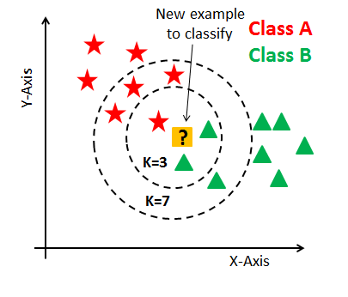
K-Nearest Neighbors
The KNN algorithm assumes that similar things exist in close proximity. In other words, similar things are near to each other. The KNN algorithm hinges on this assumption being true enough for the algorithm to be useful. KNN captures the idea of similarity (sometimes called distance, proximity, or closeness) with some mathematics we might have learned in our childhood— calculating the distance between points on a graph.

Slide 13
Multinomial Naïve Bayes
Multinomial Naive Bayes algorithm is a probabilistic learning method that is mostly used in Natural Language Processing (NLP). The algorithm is based on the Bayes theorem and predicts the tag of a text such as a piece of email or newspaper article. It calculates the probability of each tag for a given sample and then gives the tag with the highest probability as output. Naive Bayes classifier is a collection of many algorithms where all the algorithms share one common principle, and that is each feature being classified is not related to any other feature. The presence or absence of a feature does not affect the presence or absence of the other feature

Slide 14
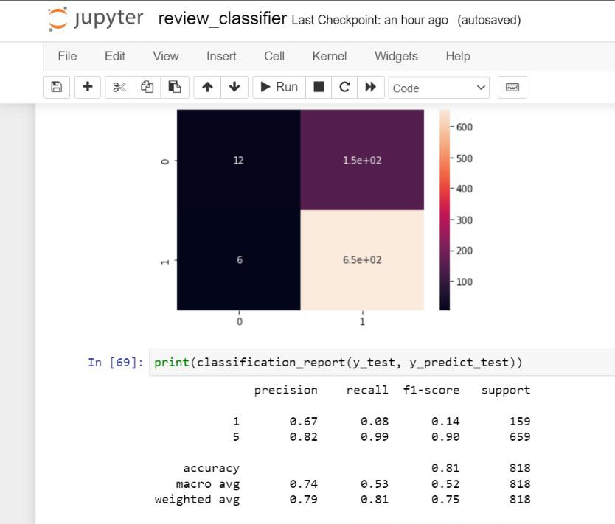
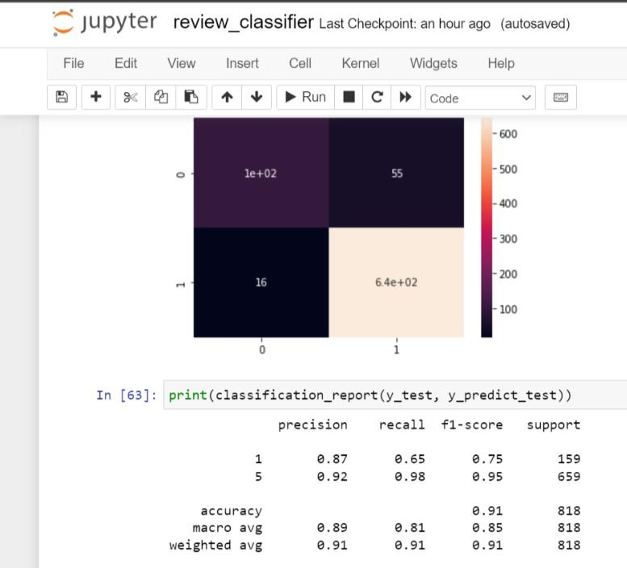
Results

Slide 15
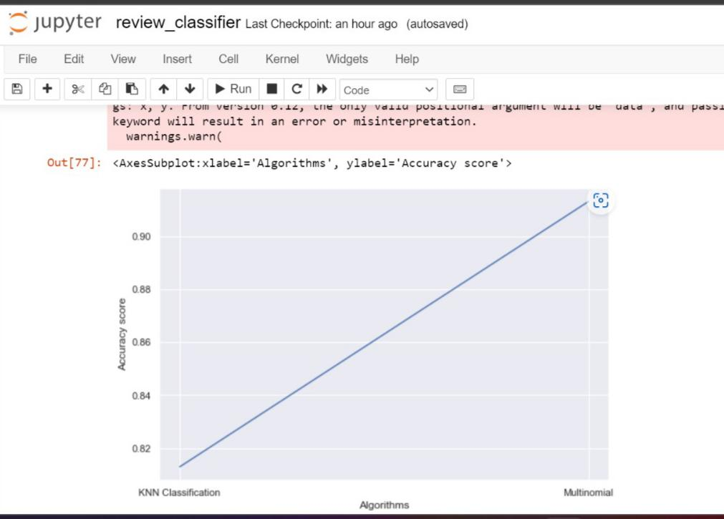
Results

Slide 16
Thank You

